Slide 1

Financial and Management Accounting (FMA) / Managerial Accounting
Prof. Ankita Nagpal Mob: 8800464400

Slide 2
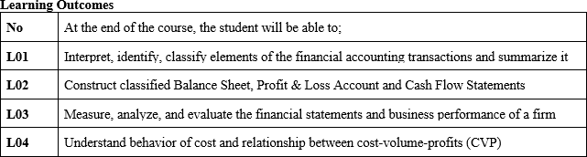

Slide 3
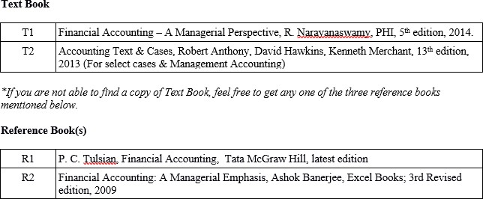

Slide 4
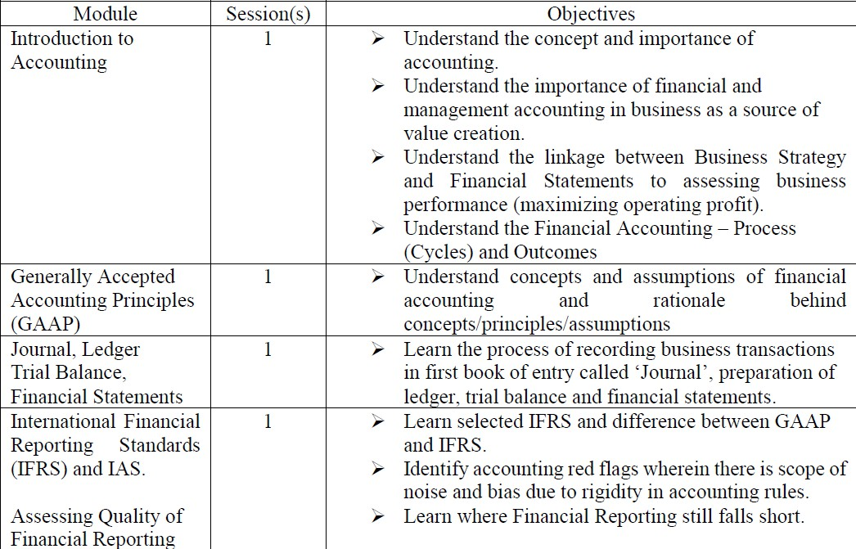

Slide 5
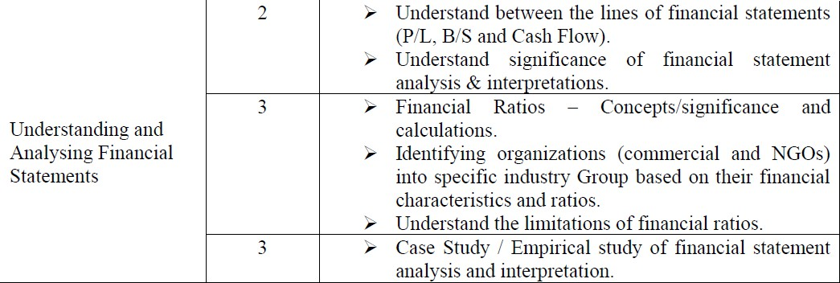

Slide 6
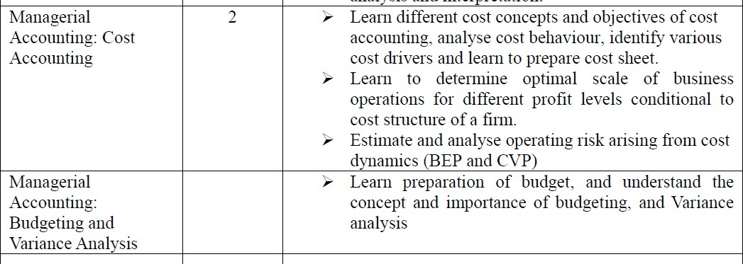

Slide 7
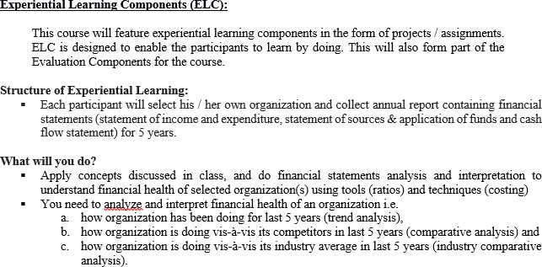

Slide 8
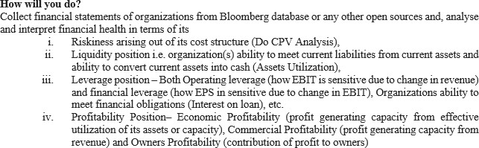

Slide 9
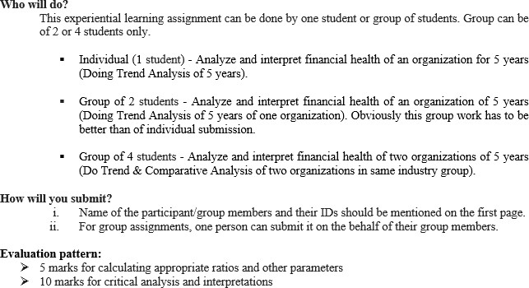
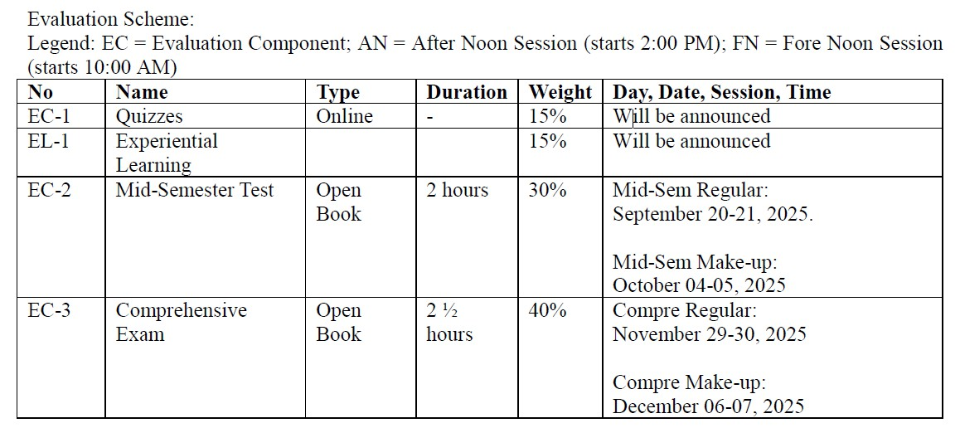

Slide 10

Organization’s Objective : Profit
Maximization - Propositions
Operating Profit Maximization =
f(Revenue Maximization or Cost Minimization Maximization is greater than cost maximization.
or Revenue
If VC > 60% of Revenue, cost minimization may result in higher
profit than revenue maximization and vice-a-versa.

Slide 11


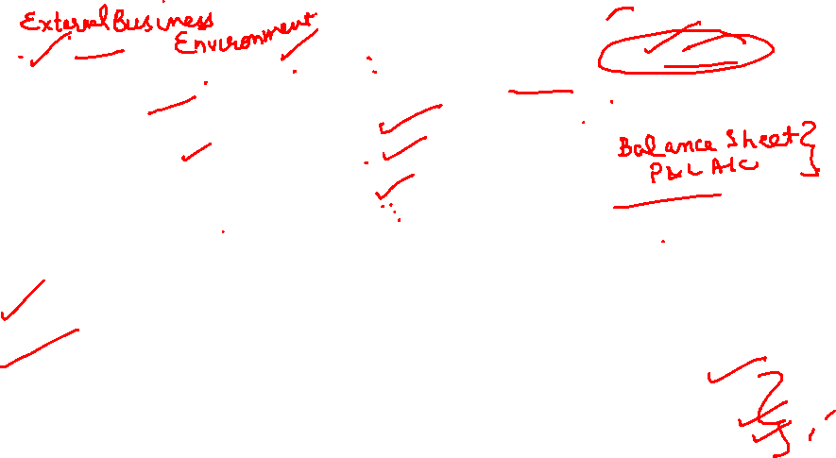
From Business Strategy to Business Activities to Financial Statements to assessing business performance (maximizing operating profit)
Market (industry/ sector) Structure & Govt Policies
Business Activities
You need mechanism to account for and convert business activities into report?
A Business Strategy
Revenue and Cost
Organization’s Vision
& Mission
Accounting System (Business Language)
Output
Financial Statements for internal and external
stakeholders
GAAP (generally accepted accounting principles)
Components of Financial Statements:
Statement of income and
expenditure,
Statement of Sources & Application of funds
Cash Flow Statement
Financial Statement Analysis & Interpretation using tools and techniques (Mgt Accounting)
7/24/2025
11

Slide 12







Slide 13

Objective of Accounting:
Provide information useful for users’ decision making. Two
primary areas of accounting are financial accounting and managerial accounting. Financial accounting is intended to provide information to external users (key external users are current and potential creditors and investors) in meeting their decision making needs.

Slide 14

Need for Accounting
Purpose of business is to make profit from operation, one must keep an ongoing track of the activities undertaken in course of business. Two basic questions would have to be answered:
What is the result of business operations?
What is the position of the resources acquired and What is the position of the resources used for business purpose (ROI, ROE) ?

Slide 15
Conti..
The answers to these questions are found by recording all the
business activities.
Recording of business activities has to be done in a scientific manner so that they reveal correct outcome.
The science of book-keeping and accounting provides an effective solution. It is a branch of social science.

Slide 16

Conti..
aims at providing a platform to the participants to
basic principles and concepts, which can be
This course
understand
applied to accurately measure performance of business.
After going through this course, you should be able to apply the principles / rules, conventions and practices to different business situations like trading, manufacturing or service.

Slide 17
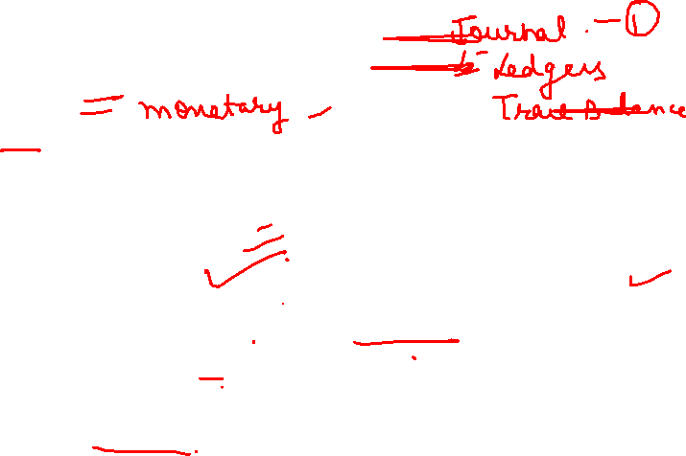
FMA - Concept
What is Financial Accounting?
Recording and reporting monetary transactions (Financial Transactions) as per statutory requirements (Generally Accepted Accounting Principles- GAAP).
Outcomes: Financial Statements (Statement of Income and Expenditure, Statement of Sources & Application of Funds and Cash Flow Statement)
Users: Internal and External

Slide 18

Major Learnings from Financial Accounting
Understood Concepts of accounting and rationale behind the
concepts.
Recognize and record (measure) revenues and expenses as per
GAAP and to prepare financial statements.
Understood various line items and importance of Financial
Statements – Analyze and interpret the financial
(performance & position) of an organization
What and how much to produce to achieve BEP?
health

Slide 19

Major Learnings from Financial Accounting (Conti….)
Measure the level of business risk (operating & financial) organization
is exposed
Understood importance of cash flow and capital blocked various components of working capital – A/R, Inventories, etc.
Understood as to why to reduce organization’s dependency on bank borrowing for working capital financing?

Slide 20
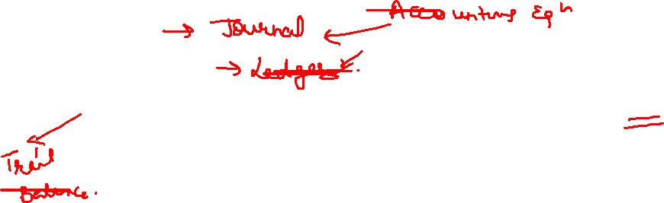
Accounting Definition- Financial Accounting
It is commonly termed as Accounting. The Indian Institute of
Certified Public Accountants defines Accounting as “an art of
recoding,
classifying and
summarizing in a significant manner and in terms of (a) money,
(b) transactions and ( c ) events which are in part at least of a
(e) financial character, and (f) interpreting the results thereof.”
Financial Accounting deals with recording and reporting financial transactions as per the statutory requirements (GAAP)

Slide 21

Accounting Definition - Financial Accounting
Financial Accounting is concerned with how entities
financial statements.
prepare
The intended user for financial accounting is external to the entity (organization).
The time period for financial accounting is historical. It means that the financial reported statements are constructed based on events which have already happened.
Financial accounting is heavily regulated and standardized

Slide 22
Accounting Definition - Financial Accounting
Therefore, the Financial Accounting course is an introduction to the fundamental concepts of financial accounting in a management context.
The course will enable you to learn how accounting systems are used to record the day-to-day economic activities of a business and places special emphasis on understanding accounting terminology.

Slide 23
Accounting Definition - Financial Accounting
You will be able to learn fundamental accounting concepts and then apply those concepts in a detailed examination of the financial statements used to describe the business.
In the course, you will be presented with real-world challenges that require them to interpret the financial data to find answers.

Slide 24
Objectives of Financial Accounting
(a) To ascertain the amount of profit or loss made by the business
i.e. to compare the income earned versus the expenses incurred and the net result thereof.
To know the financial position of the business i.e. to assess what
the business owns and what it owes.
To provide a record for compliance with statutes and laws
applicable.
To enable the readers to assess progress made by the business
over a period of time.
To disclose information needed by different stakeholders.

Slide 25
Financial Accounting – Process (Cycles)
1. The first
step in the cycle
of accounting
is to identify
will be
transactions and account under which transactions
recorded.
Transactions having financial impact only are to be recorded. There are three types of accounts

Slide 26
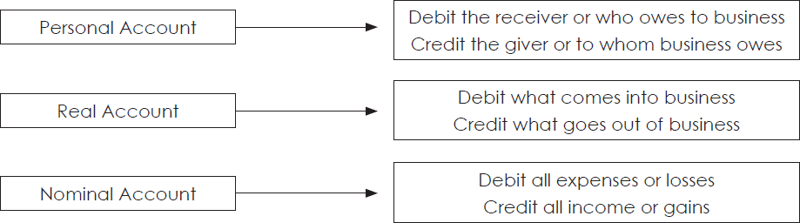

Financial Accounting - Process
2. Secondly, the recording of the business transactions (Journal
Entry) is done based on the Golden Rules of Accounting
Types of Accounts
Golden Rule

Slide 27
Financial Accounting - Process
Transaction of similar nature are grouped together and recorded accordingly (Ledger or Books of Accounts). e.g. Sales Transactions, Purchase Transactions, Cash Transactions etc.

Slide 28
Financial Accounting - Process
3. Thirdly, as the transactions increase in number, it will be difficult to understand the combined effect of the same by referring to individual records.
Hence, the art of accounting also involves the step of summarizing
(Trial Balance) them and reporting in terms of financial statements.

Slide 29

Accounting Cycle
Identify Transactions
Record Journal Entries
Ledger Posting of Entries
Unadjusted Trial Balance
Adjusted Trial Balance
Adjusted Entries
Financial Statements
Close Books of Account

Slide 30
Financial Accounting - Process
Lastly, the accounting process provides the users with financial statements which will describe what has happened to the business. Remember the two basic questions we talked about, one to know whether (1) business has made profit or loss and (2) the other to know the position of resources that are used by the business.
Statement of Income & Expenditure
Statement of Sources & Application of Funds
Cash Flow Statement

Slide 31
Outcomes of Financial Accounting
Financial Accounting is recording and reporting
monetary term as per statutory requirement (GAAP)
transactions of
Outcome of Financial Accounting:
Statement of Income & Gains and Expenses (expenditure) & Losses, (Profit & Loss Account)
Statement of Sources & Application of Fund (Balance Sheet) and
Cash Flow Statement

Slide 32


Outcomes of Financial Accounting
Profit &
Loss (P/L)
Balance Sheet (B/S)
CF

Slide 33
What is Management Accounting?
Tools and Techniques used by the management for financial decision making, budgetary control and profitability analysis, enterprise performance management, driving profitability rather than just analysing it.

Slide 34
Major Learnings from Management Accounting
Management Accounting helped to
analyze the financial position of the company through ratio
analysis.
suggest measures for improving the financial performance of organization.
analyze the profitability position of the company.
analyze assets utilization position.
determine the solvency position of company.
suggest measures for effective and efficient usage of current assets
21

Slide 35
Understanding financial and management accounting concepts, application and outcomes will enable Business Manager to analyse and interpret financial health of an organization and to take informed decisions.

Slide 36
Accounting Definition- Management Accounting
Management accounting deals with tools and techniques used
to analyze and interpret financial health of an organization.
Management Accounting (Ratios) is “the process of identification, measurement, analysis, interpretation and communication of information used by management to plan,
evaluate and control within an entity and to assure appropriate use of and accountability for its resources.

Slide 37
Accounting Definition- Management Accounting
Management Accounting is concerned with how an organization prepares reports like budgets for internal users i.e. management.
Management Accounting reports are intended for future and what may happen.
Management Accounting reports are only used within the organization, so the organization and its management are free to choose how they construct these reports.

Slide 38
Cost Accounting - Concept
The theme Cost Accountancy could be defined as application of
cost accounting principles, methods and techniques for
ascertaining and controlling/managing cost,
ascertaining profit; and
presenting information for the purpose of managerial decision-making.”

Slide 39
Significance of Cost Accounting
Cost Accounting is frequently used to facilitate internal decision making and provides tools with which management can appraise performance and control costs of doing business.
It primarily involves relating the costs to the different products produced and sold or services rendered by the business.

Slide 40
Financial Accounting vs.Cost Accounting
While Financial Accounting deals with (1) recording and reporting
(2) monetary business transactions (at a broader level) as per (3)
statutory requirements (GAAP),
Cost Accounting aims at further breaking it up to the last possible
level to identify costs with products and services.

Slide 41
FMA leading to Financial Analytics a component of Business Analytics
The goal of financial analytics, a component of business analytics, is to shape business strategy through reliable data, factual insight rather than intuition.
Financial analytics offers insight into organizations' financial status and improves the profitability, cash flow and value of the business. Financial analytics also helps companies improve income statements and business processes.

Slide 42
Financial Analytics – Concept and Types:
Financial analytics offers various views of companies' past, present and future performance. The following are key types of analytics that can help companies of different sizes:
Predictive sales analytics ( Revenue Forecasting: Variables from Financial Statement – Financial Accounting)
Client profitability analytics (Profitable clients: Internal variables –
Management Accounting)
Product profitability analytics (Profitable products / services – Cost Accounting / management accounting)

Slide 43
Cash-flow analytics (regression analysis to predict operating cash flow: working capital ratio and cash conversion cycle – Financial and Management Accounting)
Value-driven analytics (Focussing on business' value drivers, or the key
"levers“ - Financial and Management Accounting)
Shareholder value analytics (examining the returns
organization
provides to shareholders, is used concurrently with revenue analytics - Financial and Management Accounting)
profit and

Slide 44
Types of Financial Analysis
Predictive Analysis answers “What will happen in future and when”. This involves the art of forecasting. To predict the future occurrence of a particular event, the analyst needs to build a model or algorithm for identifying the various necessary components.

Slide 45
Prescriptive Analysis answers “How can I make it happen?” Diagnosis and prediction are useless without recommendations or suggestions as to how to bring about improvement.

Slide 46
Descriptive
conducting
Analysis
financial
explains “What happened”
ratio to compare RoI
For example
on historic
performance using visualization and text mining tools.

Slide 47
Diagnostic Analysis offers an answer to “How did it happen and why it happened and it will also try to bring out solutions to stop such occurrences.
For example, if there is reduced number of orders by a particular client in the previous year, the Diagnostic analysis will get to cause as to how and why it happened.
Not just this, it will also try to bring out solutions to stop such occurrences.

Slide 48
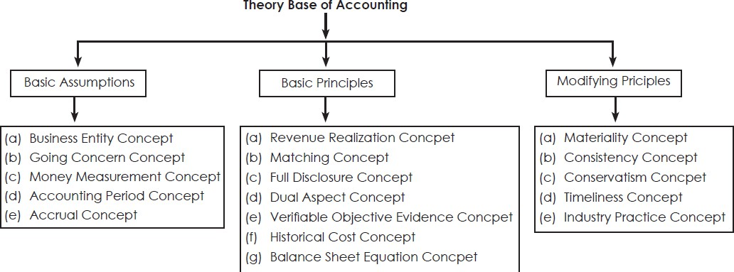
ACCOUNTING CONCEPTS AND CONVENTIONS

